Slide 1
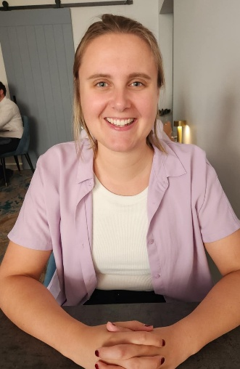
Ontology in Industry.
On Industrial Data Ontology, Domain Driven Design and Query Contexts for Data Interoperability and GenAI.
Mikkel Haggren Brynildsen, Chief Data Scientist, Data&AI Grundfos
joint work with dr. Caitlin Woods, Grundfos and UWA.
FOIS 2025
Caitlin Woods, Grundfos/UWA

Slide 2
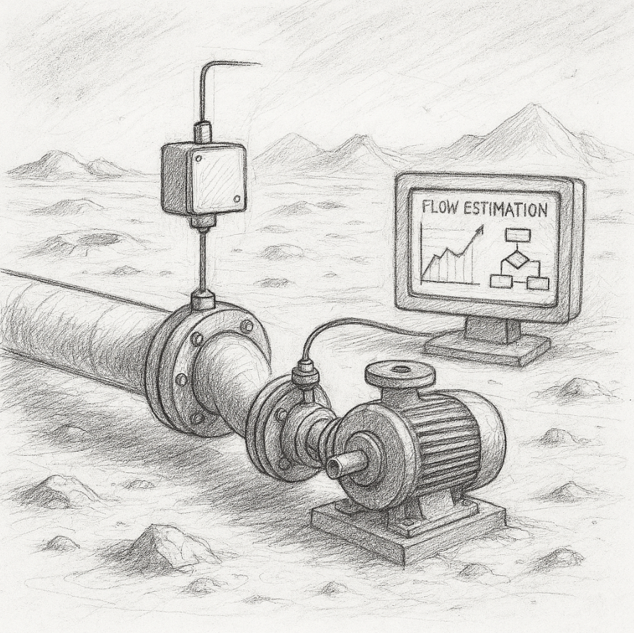
Outline
How ontologies are being used in Grundfos today
Supporting creation of good domain ontologies. Domain Driven Design Approach.
Modelling Contexts as entities themselves?
LLM question Context ontologies.

Slide 3
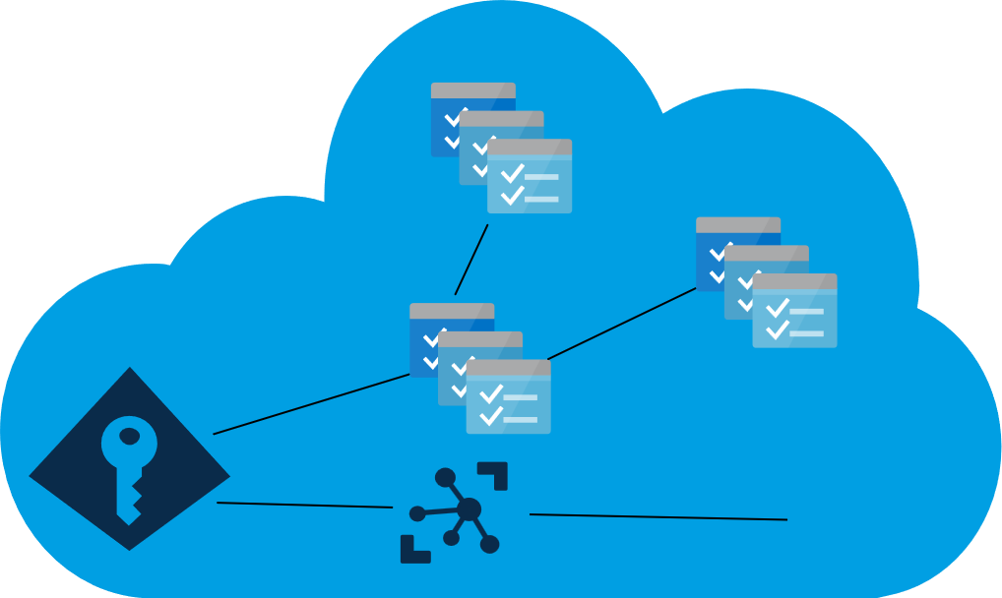
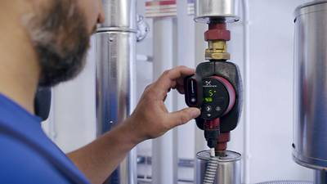

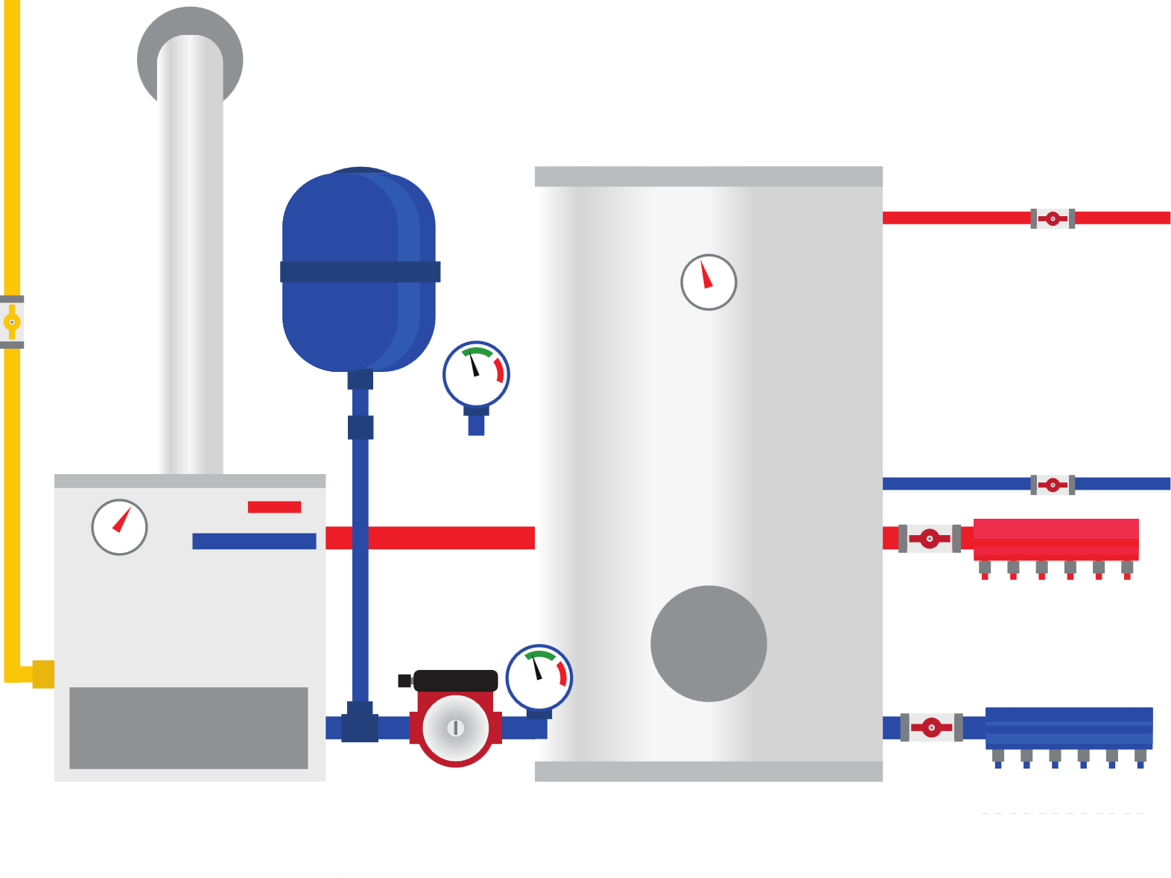


Water Systems
CRM
IoT
Product
Knowledge
Grundfos is a leading pump
manufacturer
“Alpha2” Circulator
pump

Slide 4
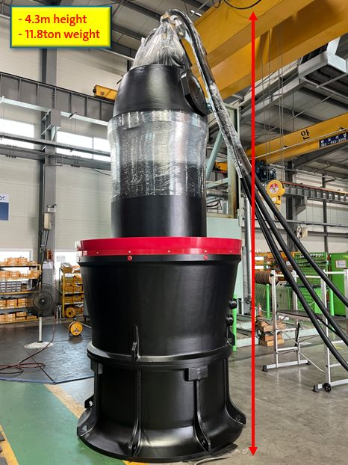
KPL Flood control pump
2070 liters / second

Slide 5
Grundfos some numbers
20,818 Employees.
Facilities in more than 60 countries.
DKK 33,2bn revenue in 2024
15,000,000 units produced every year
~500,000 categories of “product items”, ~4,500,000 material numbers in scope.
~1000 new material numbers (types of products, materials, components) generated each day. (most generated by smart “Configurators”)
Business active in the domain of water(fluid) system control and optimization. Ambition: managing millions of connected devices, have an impact on UN:SDG 6 and 13. (Clean Water and Climate action)

Slide 6
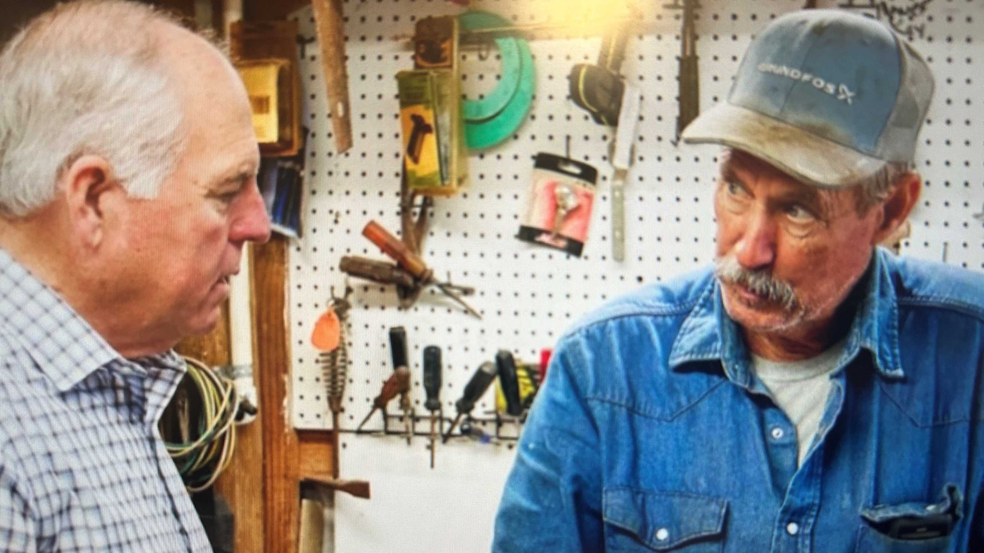

Slide 7
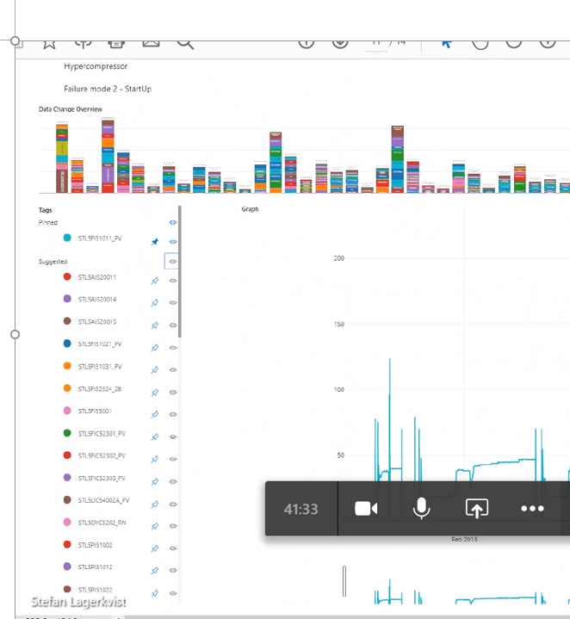
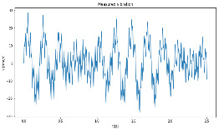
Why Ontologies in Grundfos?
Machine-readable?
Annotation Tools
Training data
storage
PRODUCTS
APPLICATIONS
FAILURE MODES
E3
A
E2
E1
P Family
B
E4
E5
Enterprise product &
fault vocabulary

Slide 8
How ontologies are being used in Grundfos today

Slide 9
How ontologies are being used in Grundfos today
Units of measure and Qualities “Lingua franca” (IDO based)
Validating quality / uom match. Enabler for “smart shopping cart” type applications.
Enterprise Shared “Data Vault 2.0” data model support
IDO use case “Pump with firmware”
Grundfos Ontology Tool, ISO 23726-3 “Industrial Data Ontology” (IDO) ecosystem, OTTR templates.
WHAT
HOW

Slide 10
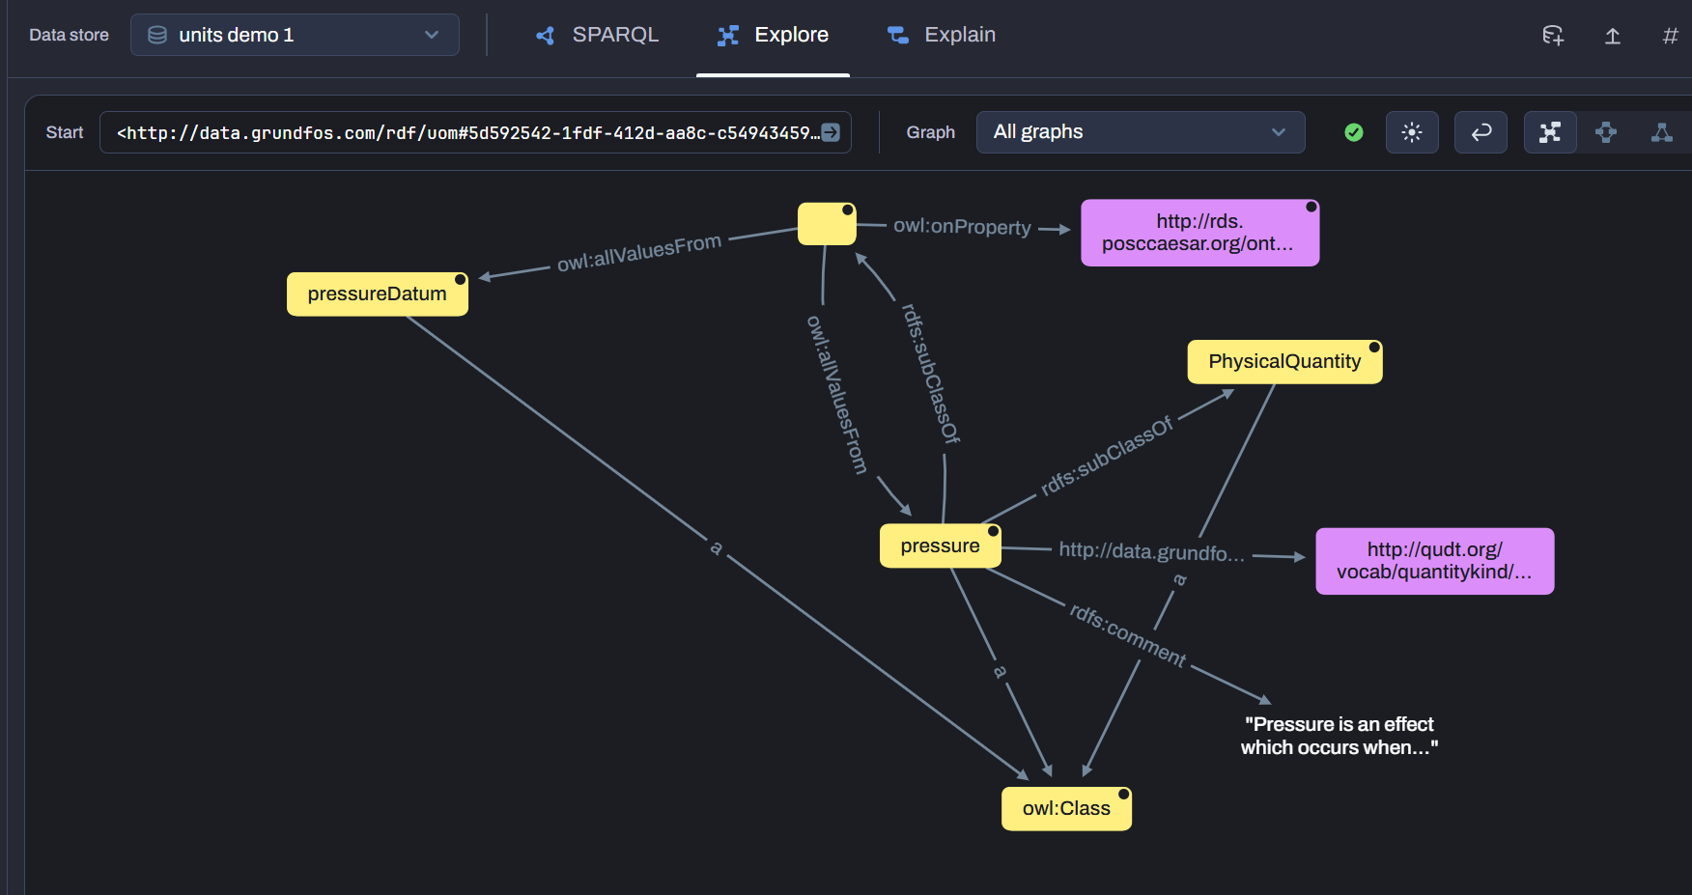
Units of measure and Qualities “Lingua franca” (IDO based)
IDO aligned templates - https://rds.posccaesar.org/doc/patterns/pattern_physical_quantity_quantification/

Slide 11
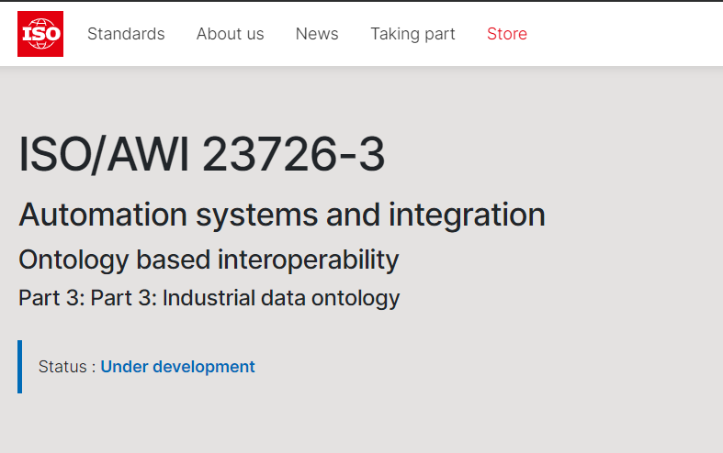
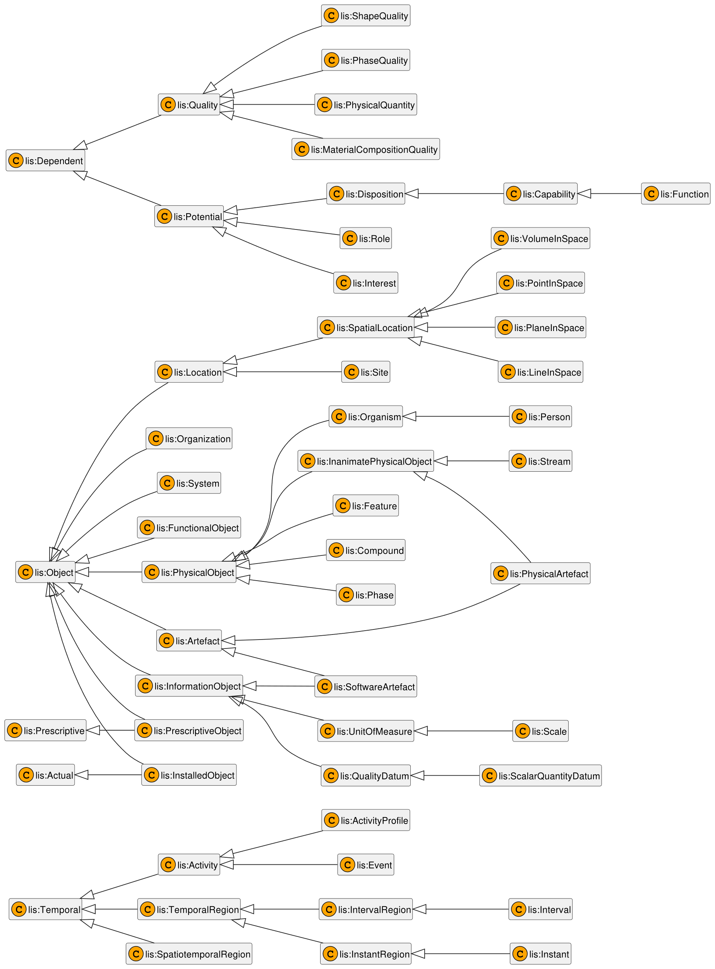
Units of measure and Qualities “Lingua franca” (IDO based), what is Industrial Data Ontology
ISO/AWI 23726-3 (IDO) is part of ISO/AWI 23726 (OBI) (Ontology-Based Interoperability) managed by ISO / TC 184 / SC 4 Industrial Data
“An ontology for representing industrial data and information, building vocabularies and manage asset models that employ reference data libraries and exploit OWL reasoning”
Derived from / inspired by
ISO 15926-2:2003
ISO/IEC 21838-2:2021 – Basic Formal Ontology (BFO)
Formulated in W3C’s OWL 2 language
Enables precise modelling
54 classes, 4 datatype properties, 88 object properties
Developed and applied in Norwegian Energy (O&G) industry
Formerly known as ‘ISO 15926-14 Data model adapted for OWL2 Direct Semantics’
In the linked data world, the namespace is “lis:” (lifecycle information system) POSC/Caesar org maintains the RDF server.
IDO’s concepts and relationships
2

Slide 12
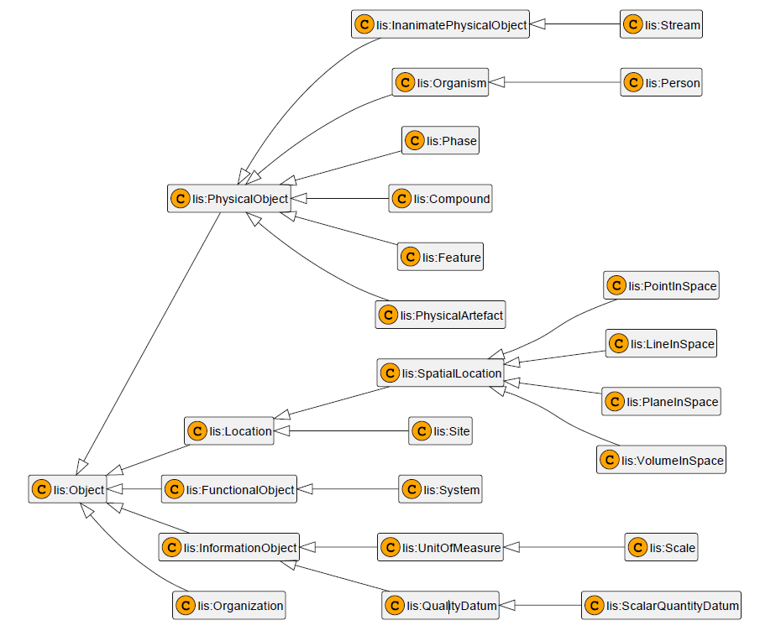
Units of measure and Qualities “Lingua franca” (IDO based), what is Industrial Data Ontology
2

Slide 13
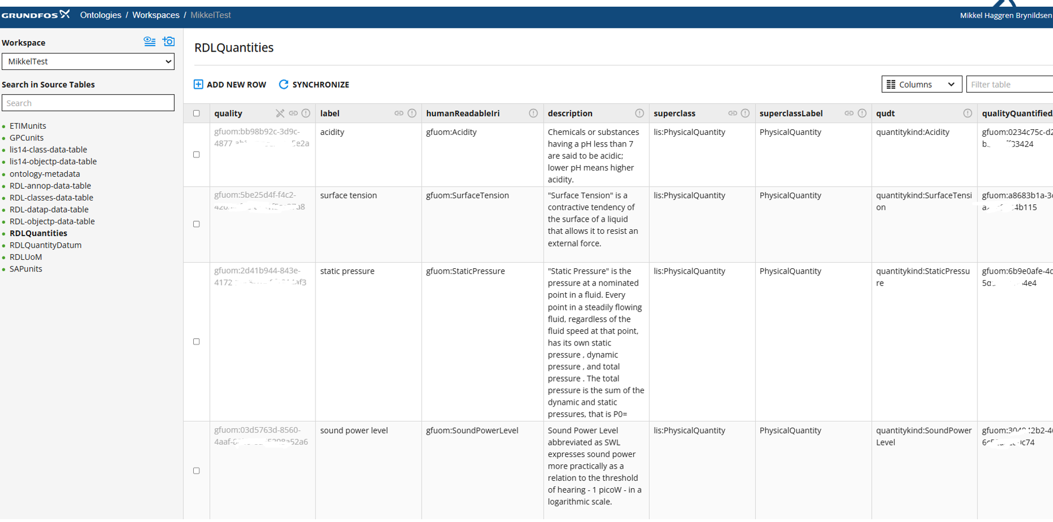
Grundfos Ontology Tool

Slide 14
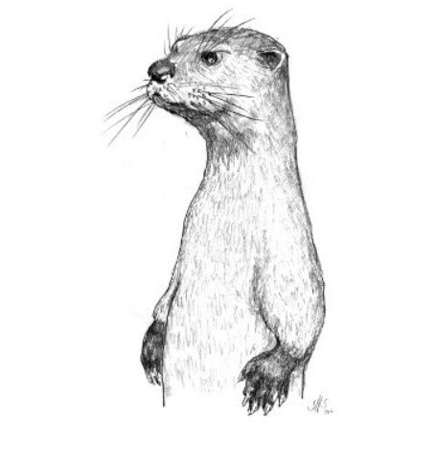
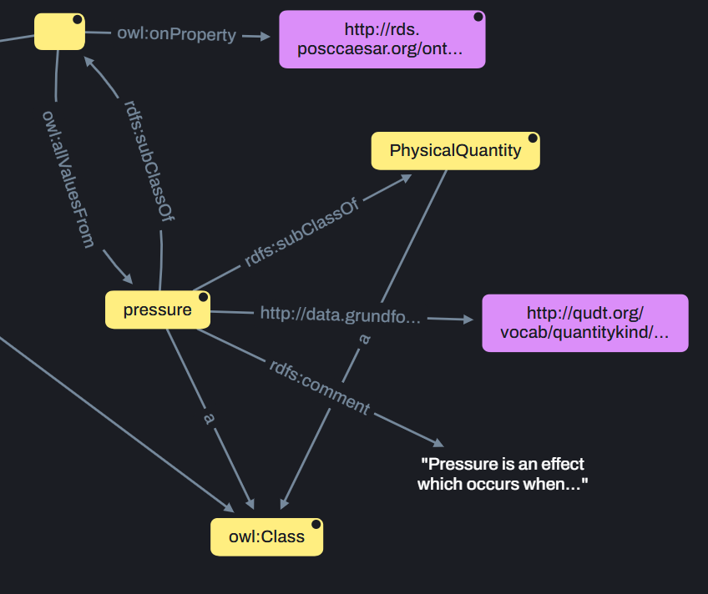
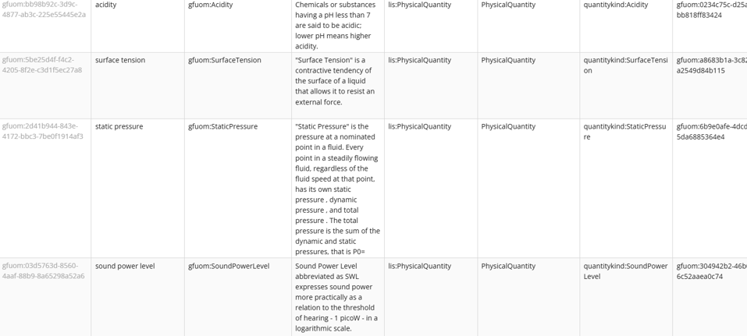
Grundfos Ontology Tool
Grundfos Ontology Tool “Workspace”
“lutra”
OTTR
Reasonable
Ontology
Templates

Slide 15
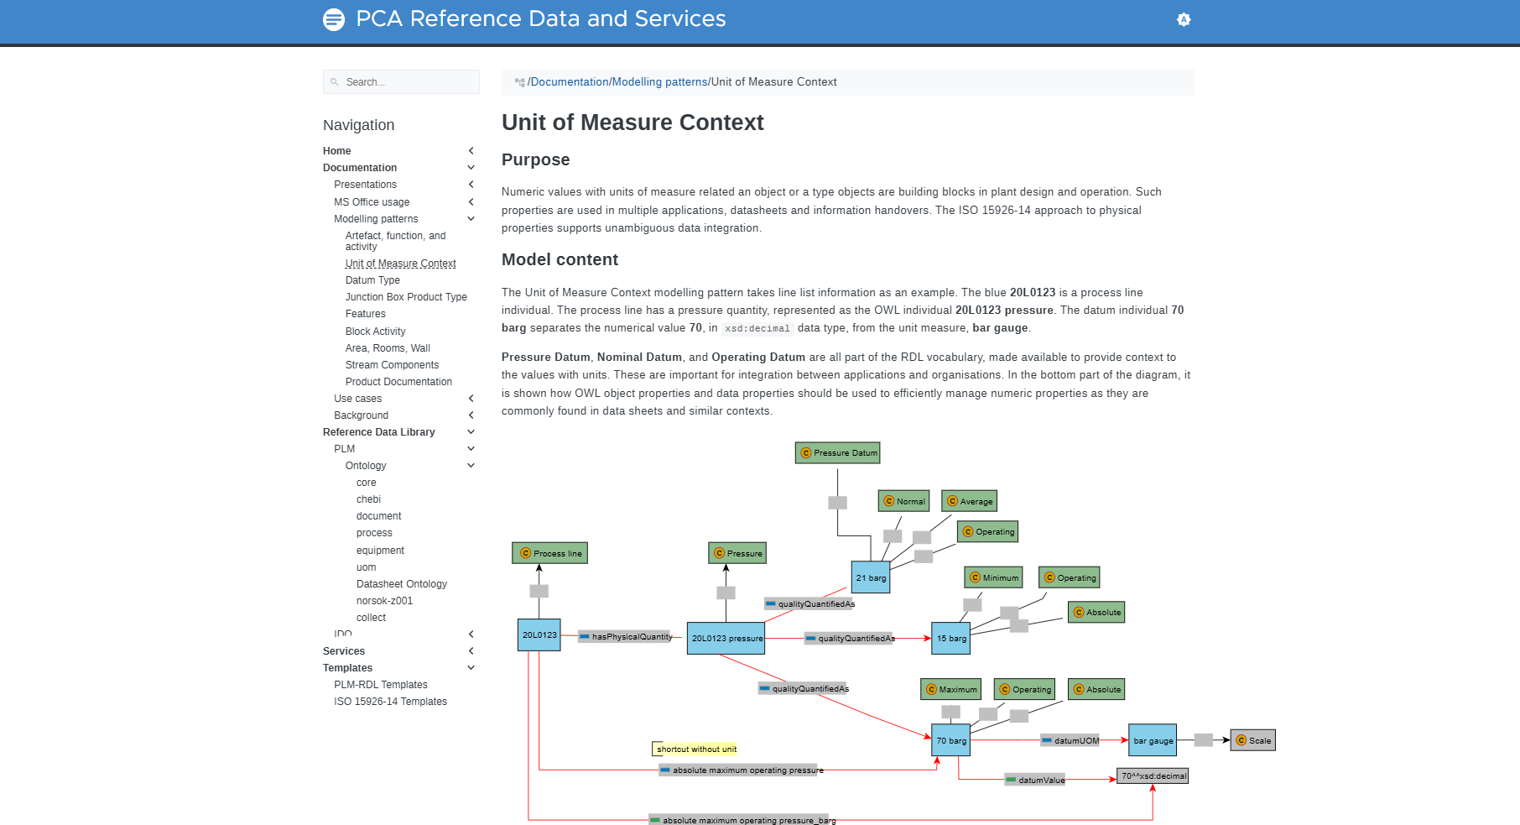
PCA modellind patterns
https://rds.posccaesar.org/doc/patterns

Slide 16
Grundfos Ontology Tool,
OTTR Templates
@prefix ottr: <http://ns.ottr.xyz/0.4/> .
@prefix plmtpl: <http://rds.posccaesar.org/ontology/plm/tpl/0.1/> .
@prefix o-owl-ax: <http://tpl.ottr.xyz/owl/axiom/0.1/> .
@prefix rdfs: <http://www.w3.org/2000/01/rdf-schema#> .
@prefix xsd: <http://www.w3.org/2001/XMLSchema#> .
@prefix owl: <http://www.w3.org/2002/07/owl#> .
@prefix gfuom: <http://data.grundfos.com/rdf/uom#> .
@prefix uomtpl: <http://data.grundfos.com/tpl/uom/0.1/> .
uomtpl:RDLQuality[
! owl:Class ?quality,
? ottr:IRI ?humanReadableIri,
? List<owl:Class> ?superclass,
!? xsd:string ?label,
!? xsd:string ?description,
? List<rdfs:Resource> ?seeAlso,
? ottr:IRI ?definedBy,
? owl:Class ?qualityOf,
? owl:Class ?qualityQuantifiedAs,
? owl:NamedIndividual ?unitConversionBase,
? ottr:IRI ?qudt
] :: {
plmtpl:RDLQuality(?quality, ?superclass, ?label, ?description, ?seeAlso, ?definedBy, ?qualityOf, ?qualityQuantifiedAs),
o-owl-ax:SubObjectHasValue(?quality, gfuom:hasBaseUnitOfMeasure, ?unitConversionBase),
ottr:Triple(?quality, gfuom:hasHumanReadableIri, ?humanReadableIri),
ottr:Triple(?quality, gfuom:hasQudt, ?qudt)
} .
OTTR
Reasonable
Ontology
Templates

Slide 17
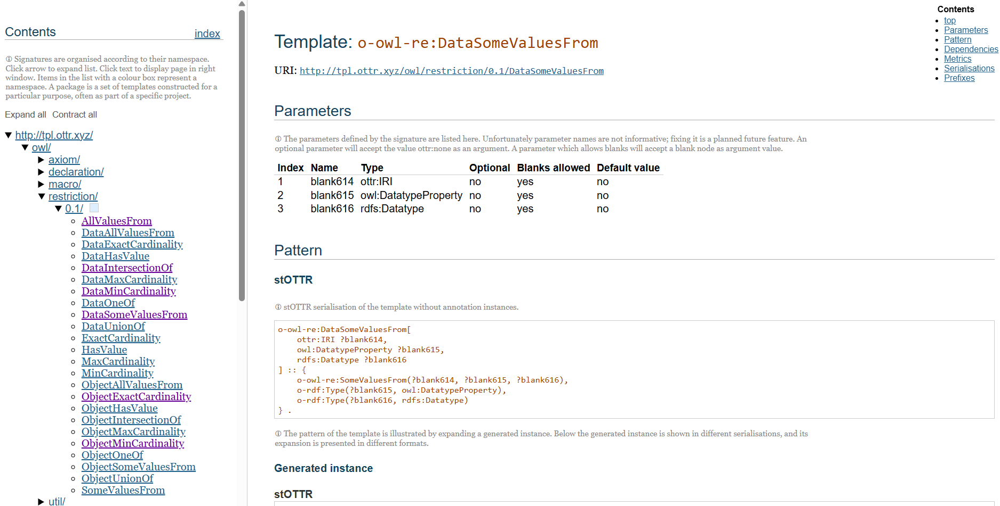
Tpl.ottr.xyz

Slide 18
Grundfos Ontology Tool, Collaborative approach to ontology development
Workspace (Branch)
Data (tables + virtualization rules)
OTTR templates
publish + approval
Master Branch v1.3.23
Master Branch v1.4.23
Master Branch v2.0.1
create
publish + approval
Git merge
Workspace (Branch)
Data (tables + virtualization rules)
OTTR templates

Slide 19
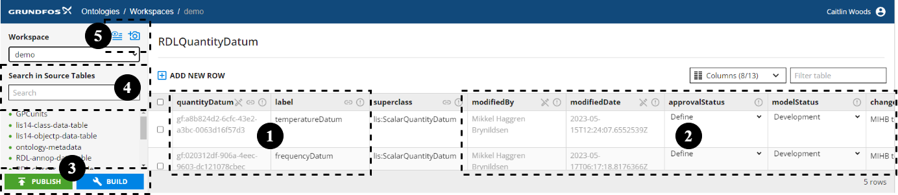
Grundfos Ontology Tool
5. Workspace Snapshots
4. Search
1. Auto-generated IRIs
3. Automated Ontology Building & Publishing
2. Auto-generated Governance Fields

Slide 20
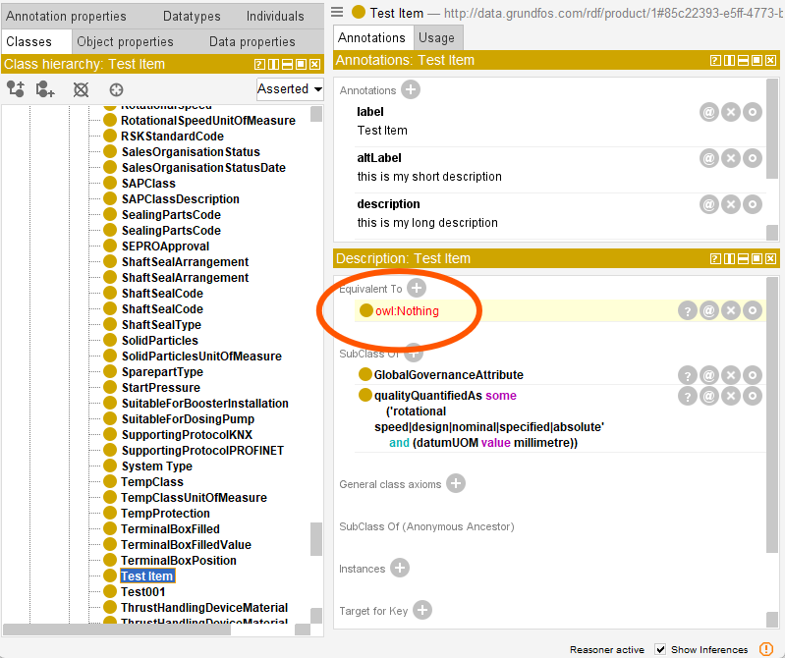

The ontology uom reasoning system unveils semantic Data Quality errors.
A data attribute is stated to be of
Quantity = “rotational speed”
But also to have
Datum unit of measure = “millimetre”

Slide 21
Supporting creation of good domain ontologies.
Understanding the context(s) in play

Slide 22
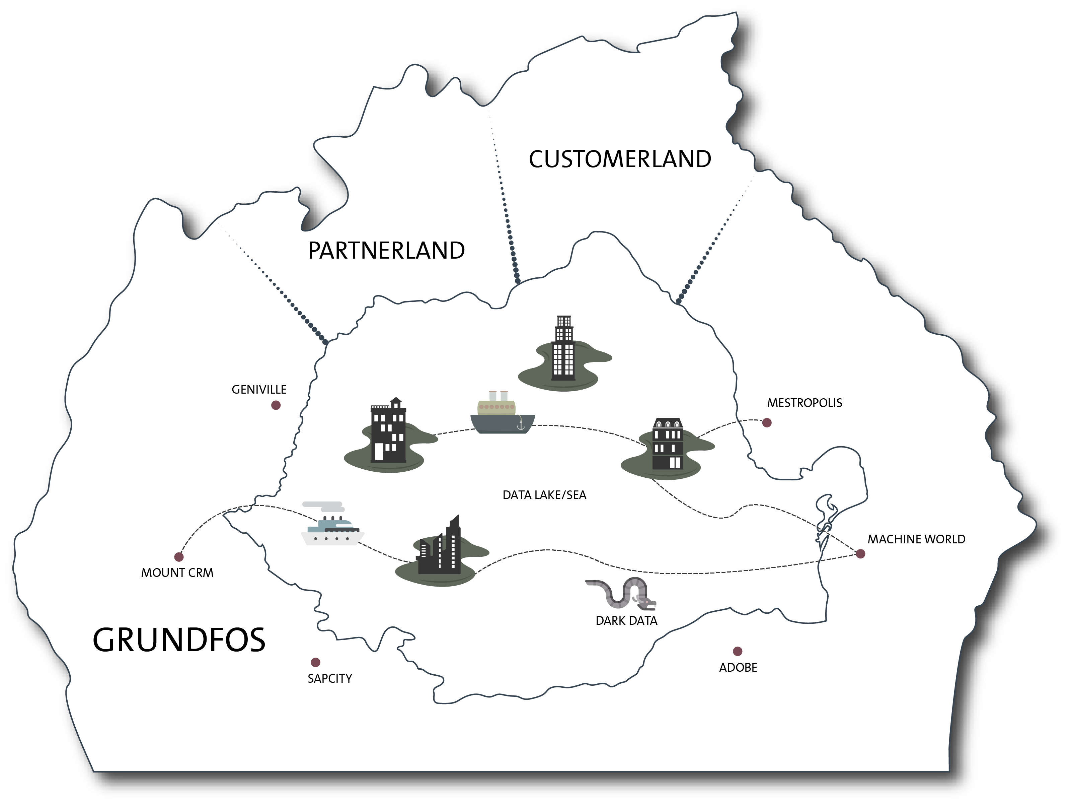




Working with DATA DOMAINS
IoT Town

Slide 23

Software Development Domain Language problems: Eric Evans citing Foote and Yoder
Big Ball of Mud
“Multiple conceptual systems mix together, making definitions and rules ambiguous or contradictory. The systems are made to work by contingent logic as features are added. Dependencies crisscross the software. Cause and effect become more and more difficult to trace. Eventually the software congeals into a big ball of mud. “

Slide 24

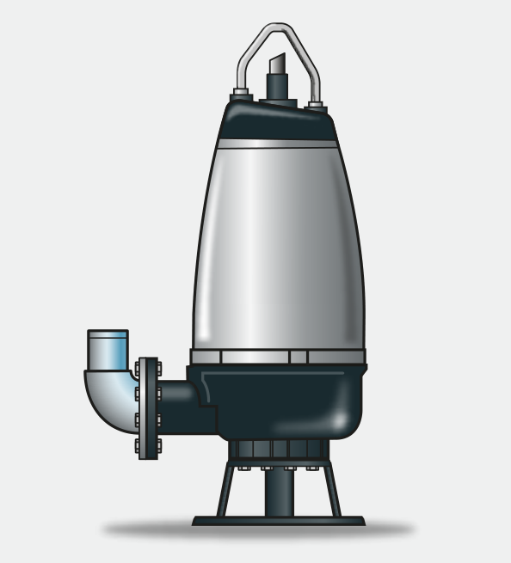
?
?
Context of “Head” unit of measure in Head Loss or Pump Head?
Very Simplified: Head is Pressure
Simplified: Head is Pressure Difference
Correct: Head is Energy Difference expressed in Meter Water Column [m]
Super Correct: Head is Specific EnergyDifference expressed in Meter Water Column [m] without ambient pressure = ”Specific Energy Head Difference [m]”
1 bar ambient pressure
h2
We do not need
v
Remark: Spefic Energy is the Energy for 1 kg
h1
There is something in between 1 and 2:
It can be a pump
It can be a long pipe that starts e.g. at El. 30m and ends at El. 94m.

Slide 25
Product and Component
Design Engineers design a Motor.
That motor is used in some products as a component, sold to some markets by some product teams.
The motor is also sold stand-alone as a product in itself by other teams.
When building the warehouse, which table does the motor type id go on?
Domain model 1
Domain model 2
Product
Component
Product
Motor
Pump
Motor
part of
Pump

Slide 26
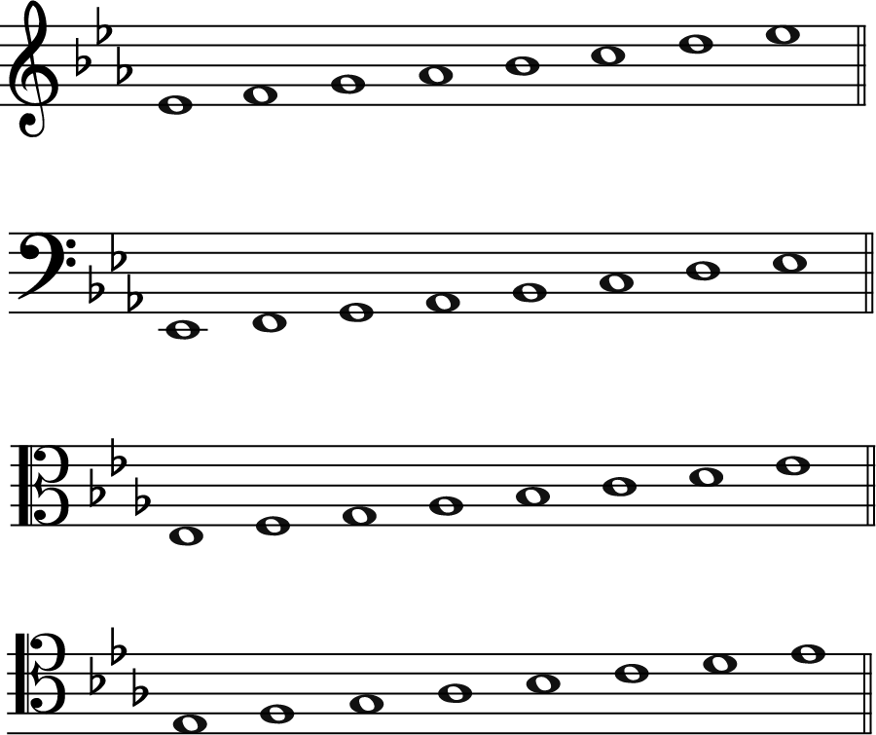
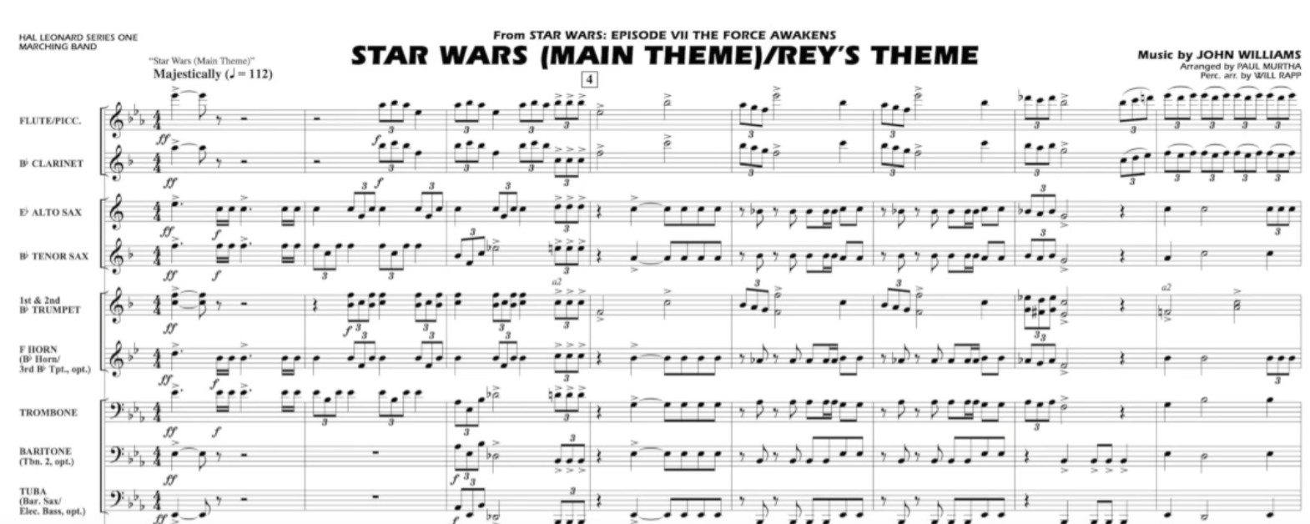
Detour: Data Mapping success story!
Eb major scale in different data languages:
“treble clef”, “bass clef”, “alto clef” and “tenor clef”.
Source: https://www.youtube.com/watch?v=Y9nNgI6Oo8g

Slide 27
Shared Kernel
“Sharing a part of the model and associated code is a very intimate interdependency, which can leverage design work or undermine it.
When functional integration is limited, the overhead of continuous integration of a large context may be deemed too high. This may especially be true when the team does not have the skill or the political organization to maintain continuous integration, or when a single team is simply too big and unwieldy. So separate bounded contexts might be defined and multiple teams formed.
Once separate, uncoordinated teams working on closely related applications can go racing forward for a while, but what they produce may not fit together. Even partner teams can end up spending a great deal on translation layers and retrofitting, meanwhile duplicating effort and losing the benefits of a common ubiquitous language.
Therefore:
Designate with an explicit boundary some subset of the domain model that the teams agree to share. Keep this kernel small.
Within this boundary, include, along with this subset of the model, the subset of code or of the database design associated with that part of the model. This explicitly shared stuff has special status, and shouldn’t be changed without consultation with the other team.
Define a continuous integration process that will keep the kernel model tight and align the ubiquitous language of the teams. Integrate a functional system frequently, though somewhat less often than the pace of continuous integration within the teams.“
Eric Evans: “DDD reference” https://tinyurl.com/DDDRefEricEvans

Slide 28
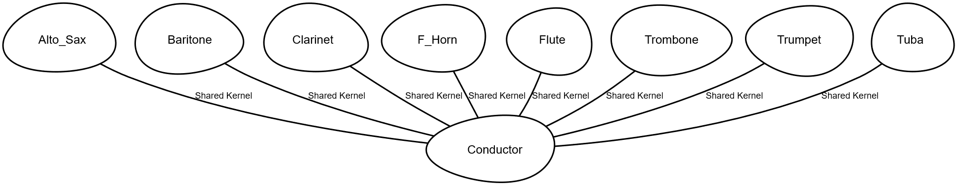
Conductor – Musician domain language relation. Shared Kernel

Slide 29
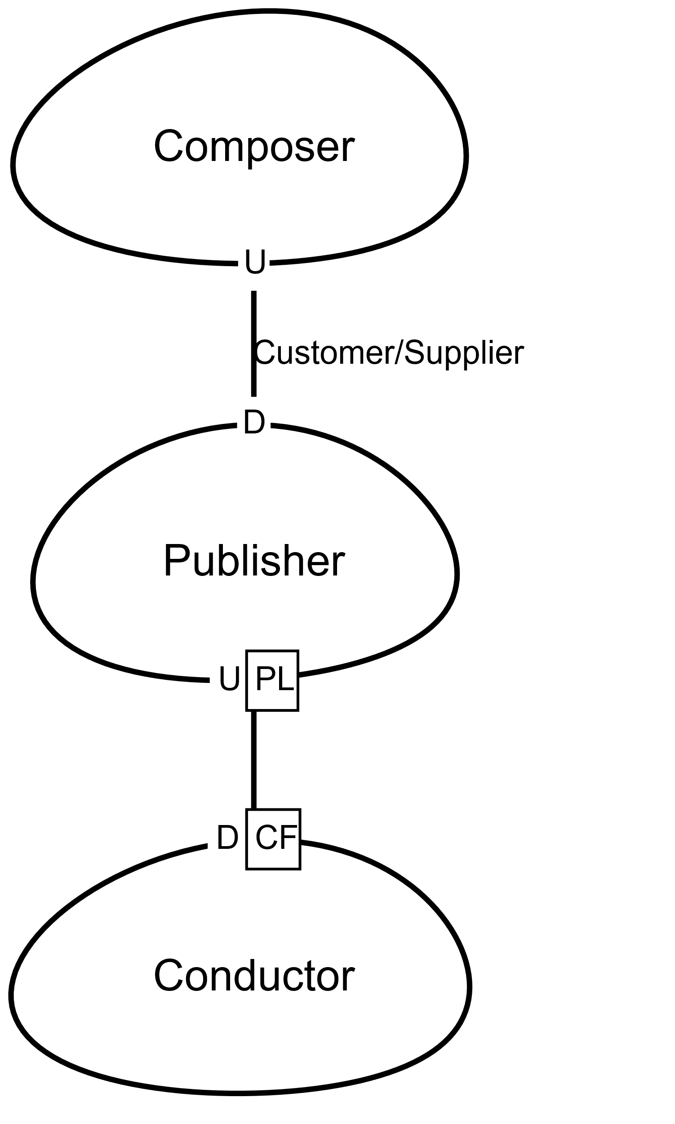
Domain Driven Design Analysis
ACL
“Lazy Conductor”
“Angry Conductor”

Slide 30
DDD Patterns of relationships between bounded contexts (Eric Evans)
Single Bounded Context
Shared kernel
Customer/Supplier
Conformist
Anticorruption Layer
Separate Ways
Open Host Service
Single Bounded Context
Shared Kernel
Control of all associated systems
Customer Supplier
PL
PL
Open Host Service
Anticorruption Layer
PL
Conformist
PL
Published Language (PL)
(upper ontology)
Separate Ways
Communication commitment

Slide 31
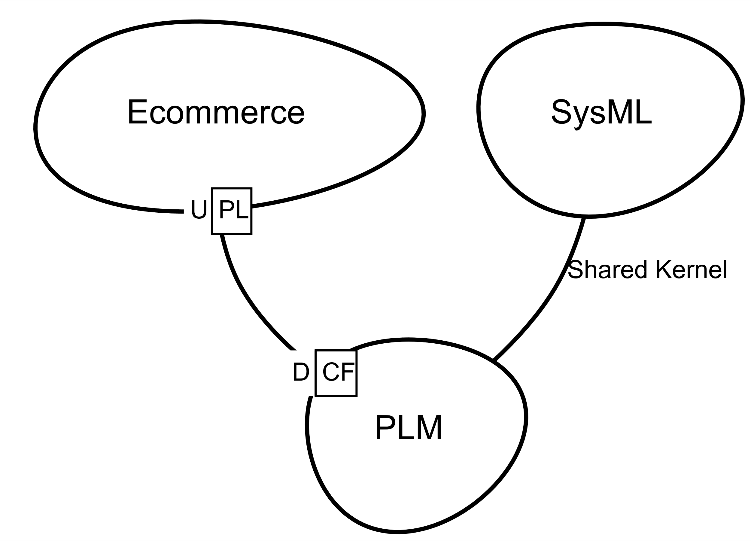
Example Contexts in Manufacturing
Each context is a separate “bounded context” in DDD terms, with its own ubiquitous language:
The engineers talk in terms of system models, requirements, and design parameters (SysML) .
The PLM team uses enterprise product data language, part numbers, and internal classification codes.
The Sales / Marketing Ecommerce context speaks ETIM (standardized product descriptors for the market).
It is not feasible to force a single schema on all of them; each exists for different purposes. However, the key data about the pump must be transmitted between these contexts accurately.
Image generated using contextmapper.org

Slide 32
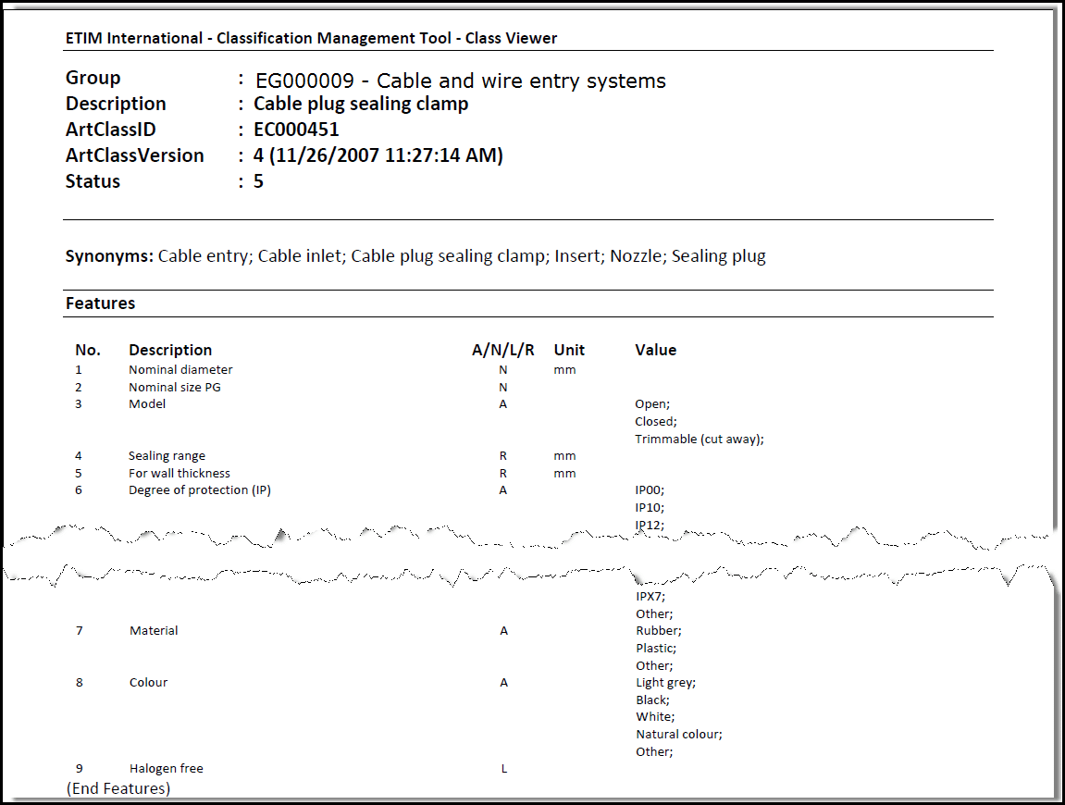
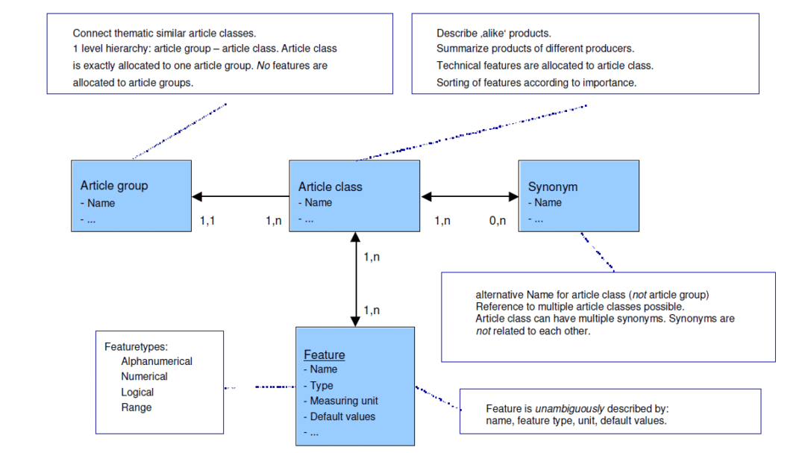
Domain 1: E-commerce
E-commerce makes logical classifications necessary for communicating product features and applications.
Example – ETIM Class Models
Products are described as groups (or classifications)
Sourced From: https://www.etim-international.com/classification/model-information/ -

Slide 33
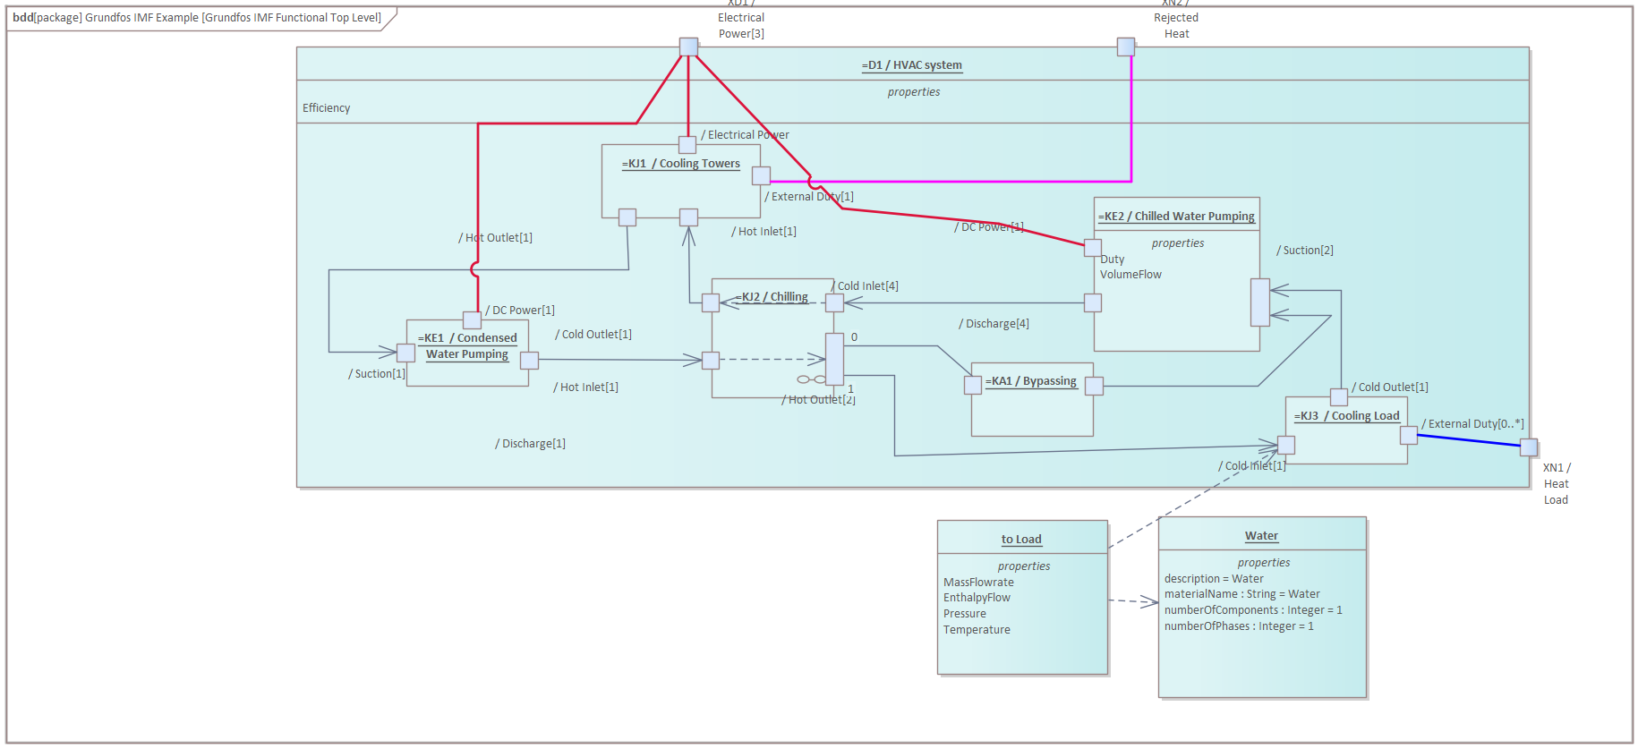
Domain 2: Engineering
Engineering deals with the design phase of a product, often thinking about how systems and subsystems interact within defined system boundaries.
Example – SysML models
Products are described in abstract categories / systems (in this case, according to function)

Slide 34
Domain 3: Product Lifecycle Management
PLM tracks products from conception to decommissioning, and are interested in how products are designed, assembled and produced (including the equipment needed for production and packaging requirements)
Example 1 - Bill of Materials
Example 2 - Production Equipment
:Material Number = 92001923 :BOM ID = 8010913 :BOM Type = MBOM :Storage Location = HTP012 :Lead Time = 3 Days :Delivery Time = 2 Days
:Restrictions Exist = False
Material (Pump) 92349298
Material (Production Equipment) 9992298
90030001
91294820
90953891
90125021
part of
is a
is a
Production Equipment Instance
3233220292 (S)
produced with
Pump Instance 15000637
part of
Sales Order
890332821
produced for
produced at
Products are described as individual objects (where components, and production equipment are also “products”)
Production Plant GNH3 - 0088

Slide 35
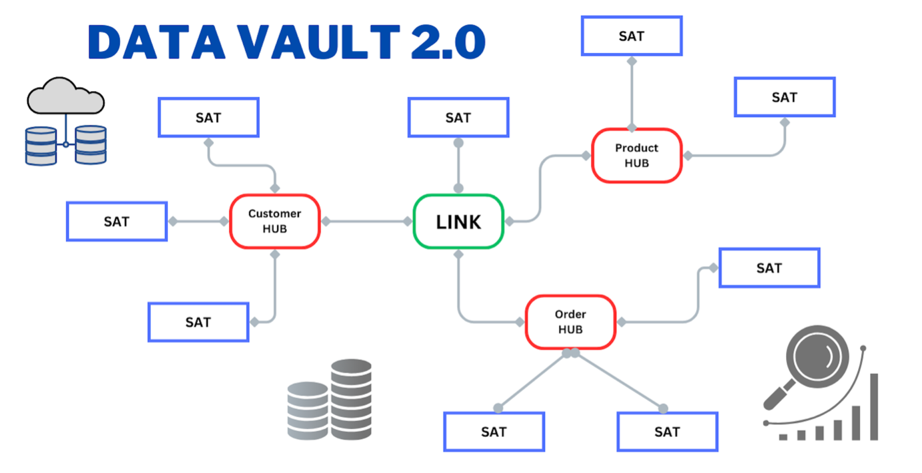
Data Vault 2.0
Name: Mikkel Brynildsen
Interest: Quantum Computing
Load_date_ts: 20250910T12:23:20
ID
DV Image Source: Pratik Khedekar

Slide 36
Value Proposition of Data Vault 2.0
Raw Data Vault Layer
Business Layer
Raw data vault
Raw data vault
Sources
“Data Mesh” of “Data Products”
Id hub
satellite
link

Slide 37
Value Proposition of Data Vault 2.0,
“Survive new sources”
Raw Data Vault Layer
Business Layer
Raw data vault
Raw data vault
“Data Mesh” of “Data Products”
Sources
Id hub
satellite
link

Slide 38

Enterprise Warehouse Top level data plan / id guide –
very close to an ontology! Plan for maximal integration flexibility
Party Role
Location
Resource
Classification Scheme
Party
Agreement
Task
Event
Financial Account
Document
Artefact
Artefact Relation
?
… Data Town Plan …
By John Giles
Artefact Role
Source: John Giles & Grundfos Data Experts.

Slide 39
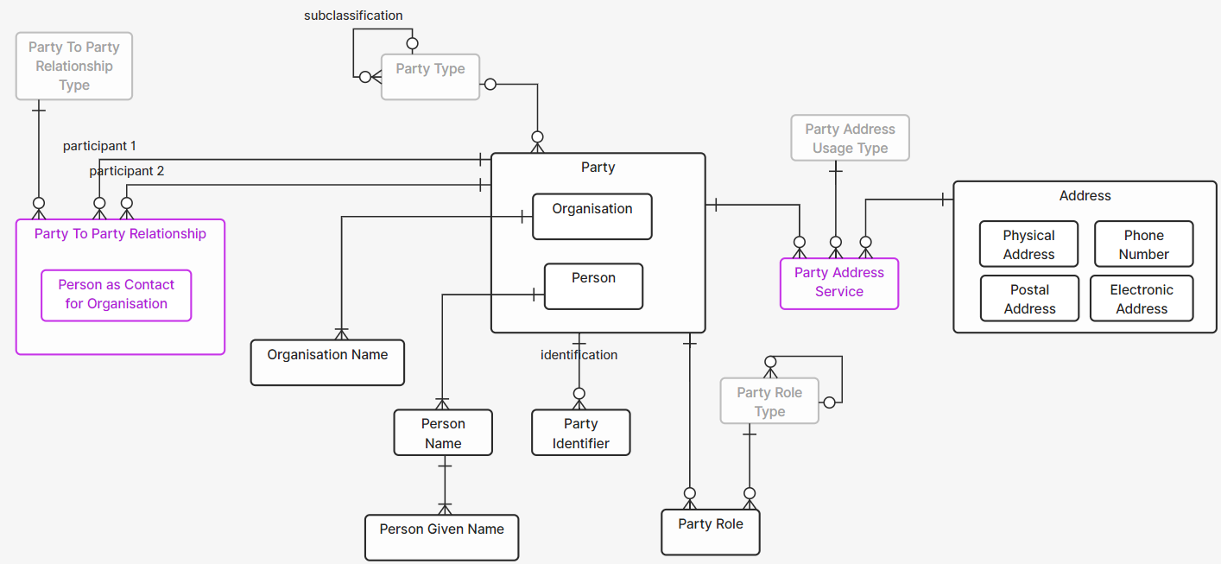
The nodes in the plan unfolds to proven Data Vault modelling patterns.
Source: https://www.ellie.ai/blogs/john-giles-data-model-patterns-in-ellie

Slide 40
3. Modelling Contexts

Slide 41


Domain Driven Design
$$Bounded Context \left(BC\right)⊂\{ Agents \} ∪\{Software \} ≡Domain$$
Domain
Software system 1
Terminology Relation
Software system 2

Slide 42
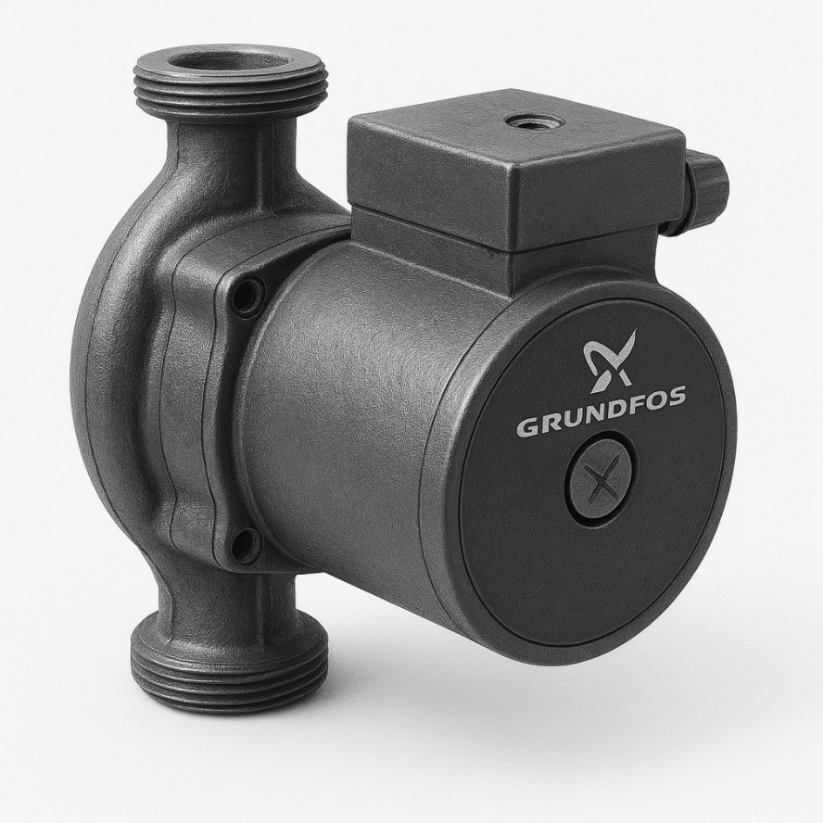
IMF has formulated attributes of Aspect views on Systems.
In IMF an Aspect is defined by specifying the following triple <Perspective, Interest, Modularity>.
<Perspective, Interest, Modularity>.
SYSTEM DESIGN
MANUFACTURING COMMISIONING SALES/MARKETING MAINTENANCE
REQUIREMENT
INTENDED SOLUTION
ACTUAL SOLUTION
ACTIVITY
LOCATION
ARTEFACT

Slide 43
Understand Query Context
Beliefs
Desires
Intensions
Domain
Software system 1
Terminology Relation
Software system 2
QUERY

Slide 44
Understand Query Context
Upper Ontology
Query Answering Ontology
BC 2
Domain ontology
module
BC1
Terminology Relation
QUERY
BC 3
Domain ontology
module

Slide 45
3. LLM conversation Context Ontologies.

Slide 46
Retrieval Augmented Generator (RAG)
Embedding
Model
Vector Database
Document Chunks
encode
index
Query
Context
Relevant document chunks
+
Query
Similarity
Search
Query
encode
retrieval
Answer
LLM
Prompt

Slide 47
Fact augmented RAG? (just a kind of function calling? / “agent”)
Structured Data
Domain Ontologies
Triple Store
+
Reasoner
KG
construction
(Assembled)
Query KG
Query
Context
SPARQL
Facts
Insights
Relevant
Insights
+
document chunks
+
Query
Bounded
Context List
?? Possible ??
Document Chunks
encode
index
Embedding &
Ontology Orchestrator
Vector Database
Similarity
Search
retrieval
Query
encode
Answer
LLM
Prompt

Slide 48

Conclusions
Think about how ontologies can scale to real world data and organizations. Ontology Lifecycle and governance is part of “definition of done”!
You are not alone, Modelling patterns can be shared with dereferenceable OTTR templates.
Semantic Web Logical Reasoning can bring new types of data quality insights! These are often low hanging fruits if you build on a good upper ontology.
Domain Driven Design has theories on how Bounded Contexts relate to each other.
I find these useful in analyzing information flows in industry, a “Bounded Context map“ can focus terminology alignment efforts.
Upper ontologies can be thought of as “Published Languages” in the DDD theory, that makes the definitions of data language mappings objective and more robust.
A way to talk to enterprise data architects and scrum masters is to identify how the Bounded Context “ubiquitous languages“ and (now objective and robust) mappings in the Bounded Context Map” supports
Modern scalable Data warehousing like “Data Vault 2.0” with dealing with the “semantic blind spot”.
You can add (now semantically aligned) knowledge graphs, or even go full “Ontology Based Data Access”, (see also “Ontop”) and generate business specific information and knowledge APIs.
Let’s unleash the FRAG! (could someone figure out the SPARQL orchestration, please)

Slide 49
Motivating Question
Will the flow estimation algorithm work on the moon?
Enterprise FRAG – chatbot:
No – because the “head” data used in the standard firmware
has a unit of measure that only works in the context of
the Earth gravitational field.

